Slide 1

Speaker
Robin Castellani
Definizione del cambiamento climatico
«Per “cambiamenti climatici” si intendono i cambiamenti a lungo termine delle temperature e dei modelli meteorologici. »
Cit. Nazioni Unite - Centro Regionale di Informazioni

Slide 2
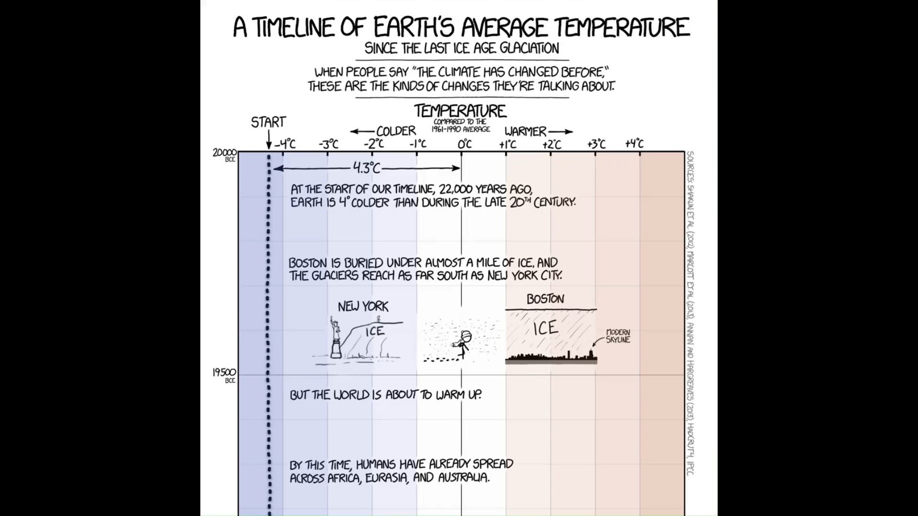
Speaker
Robin Castellani
https://xkcd.com/1732/

Slide 3
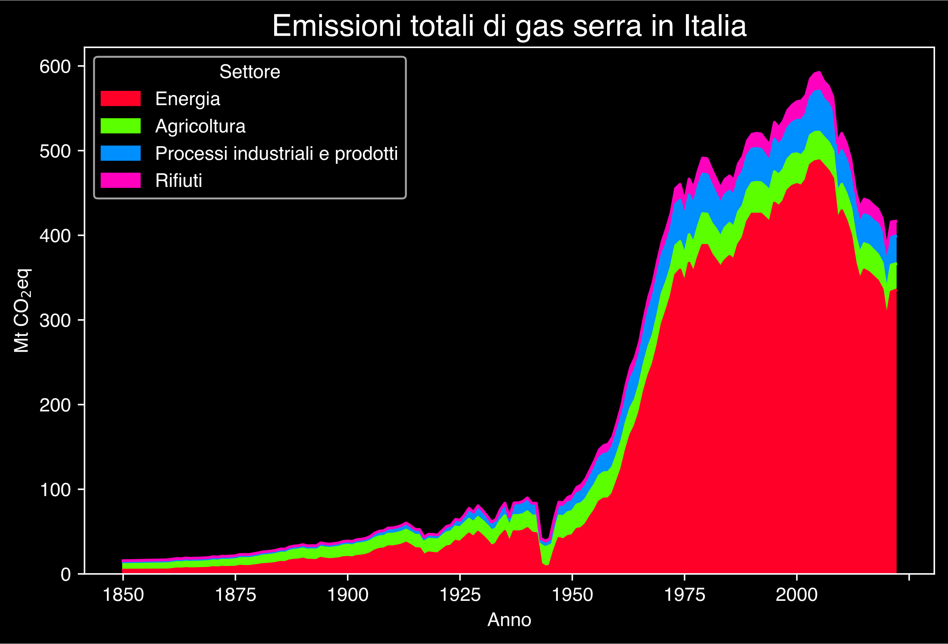
Speaker
Robin Castellani
Gütschow, J.; Pflüger, M. (2022): The PRIMAP-hist national historical emissions time series v2.4 (1750-2021). doi:10.5281/zenodo.7179775

Slide 4
Speaker
Robin Castellani
Se vuoi rendere ricco Pitocle,
non riempirlo di doni,
ma sfrondane i desideri
Epicuro

Slide 5
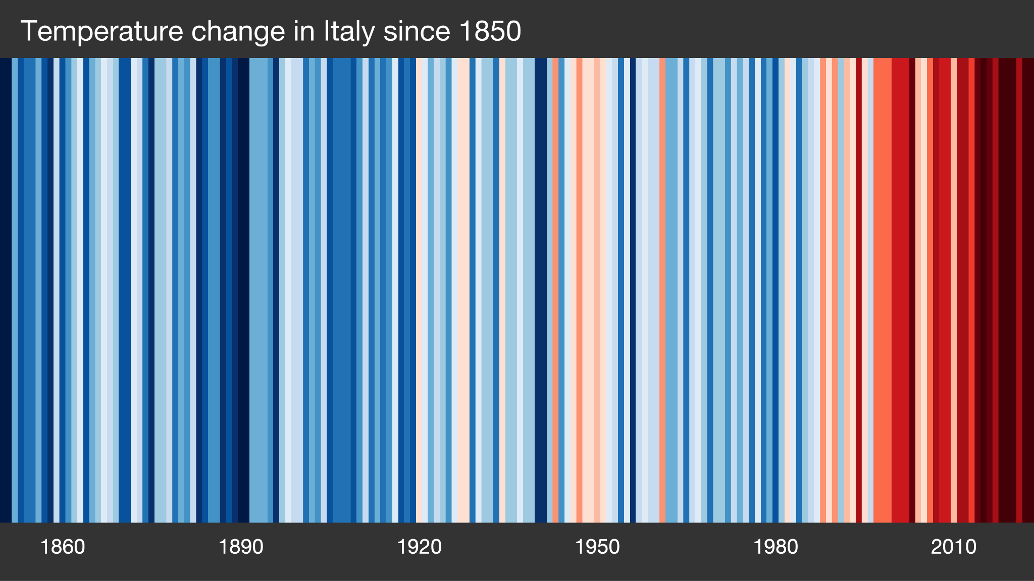
Speaker
Robin Castellani
Showyourstripes.info by Ed Hawkins, University of Reading

Slide 6
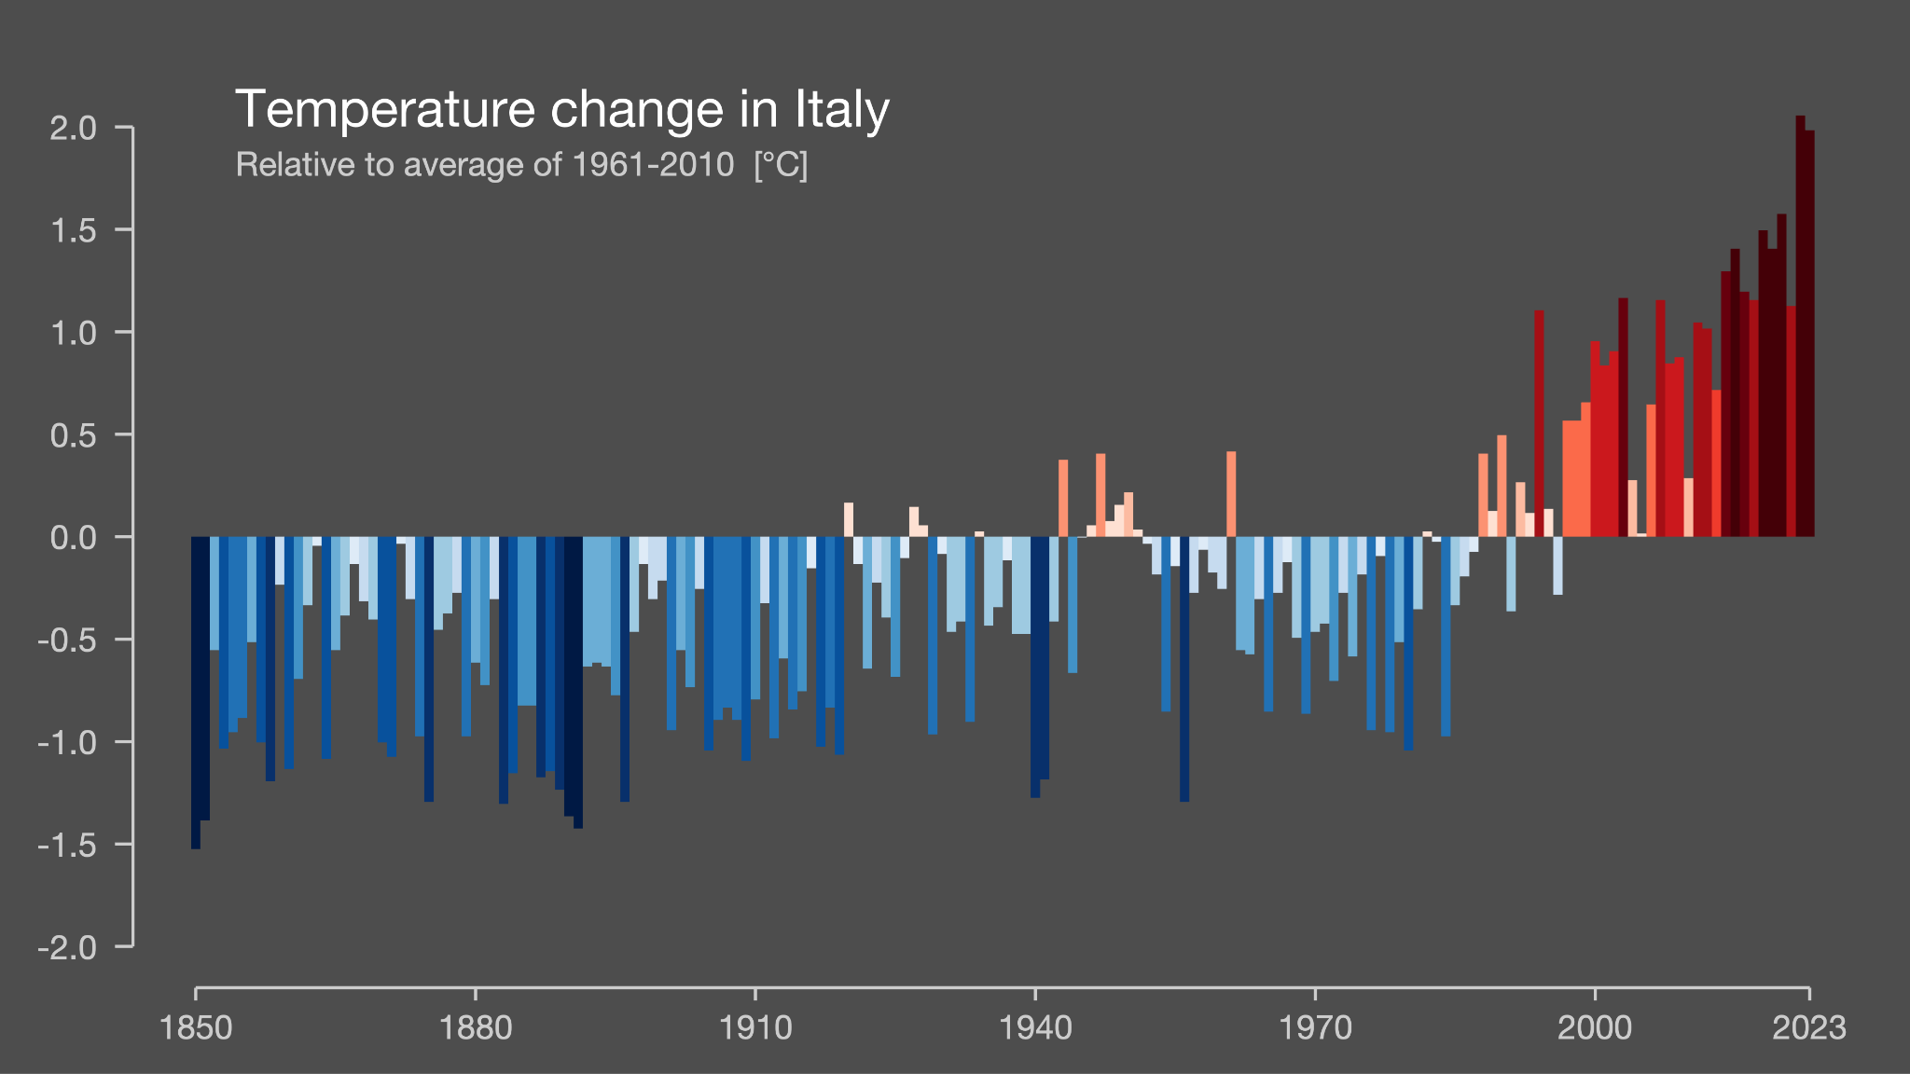
Speaker
Robin Castellani
Showyourstripes.info by Ed Hawkins, University of Reading

Slide 7
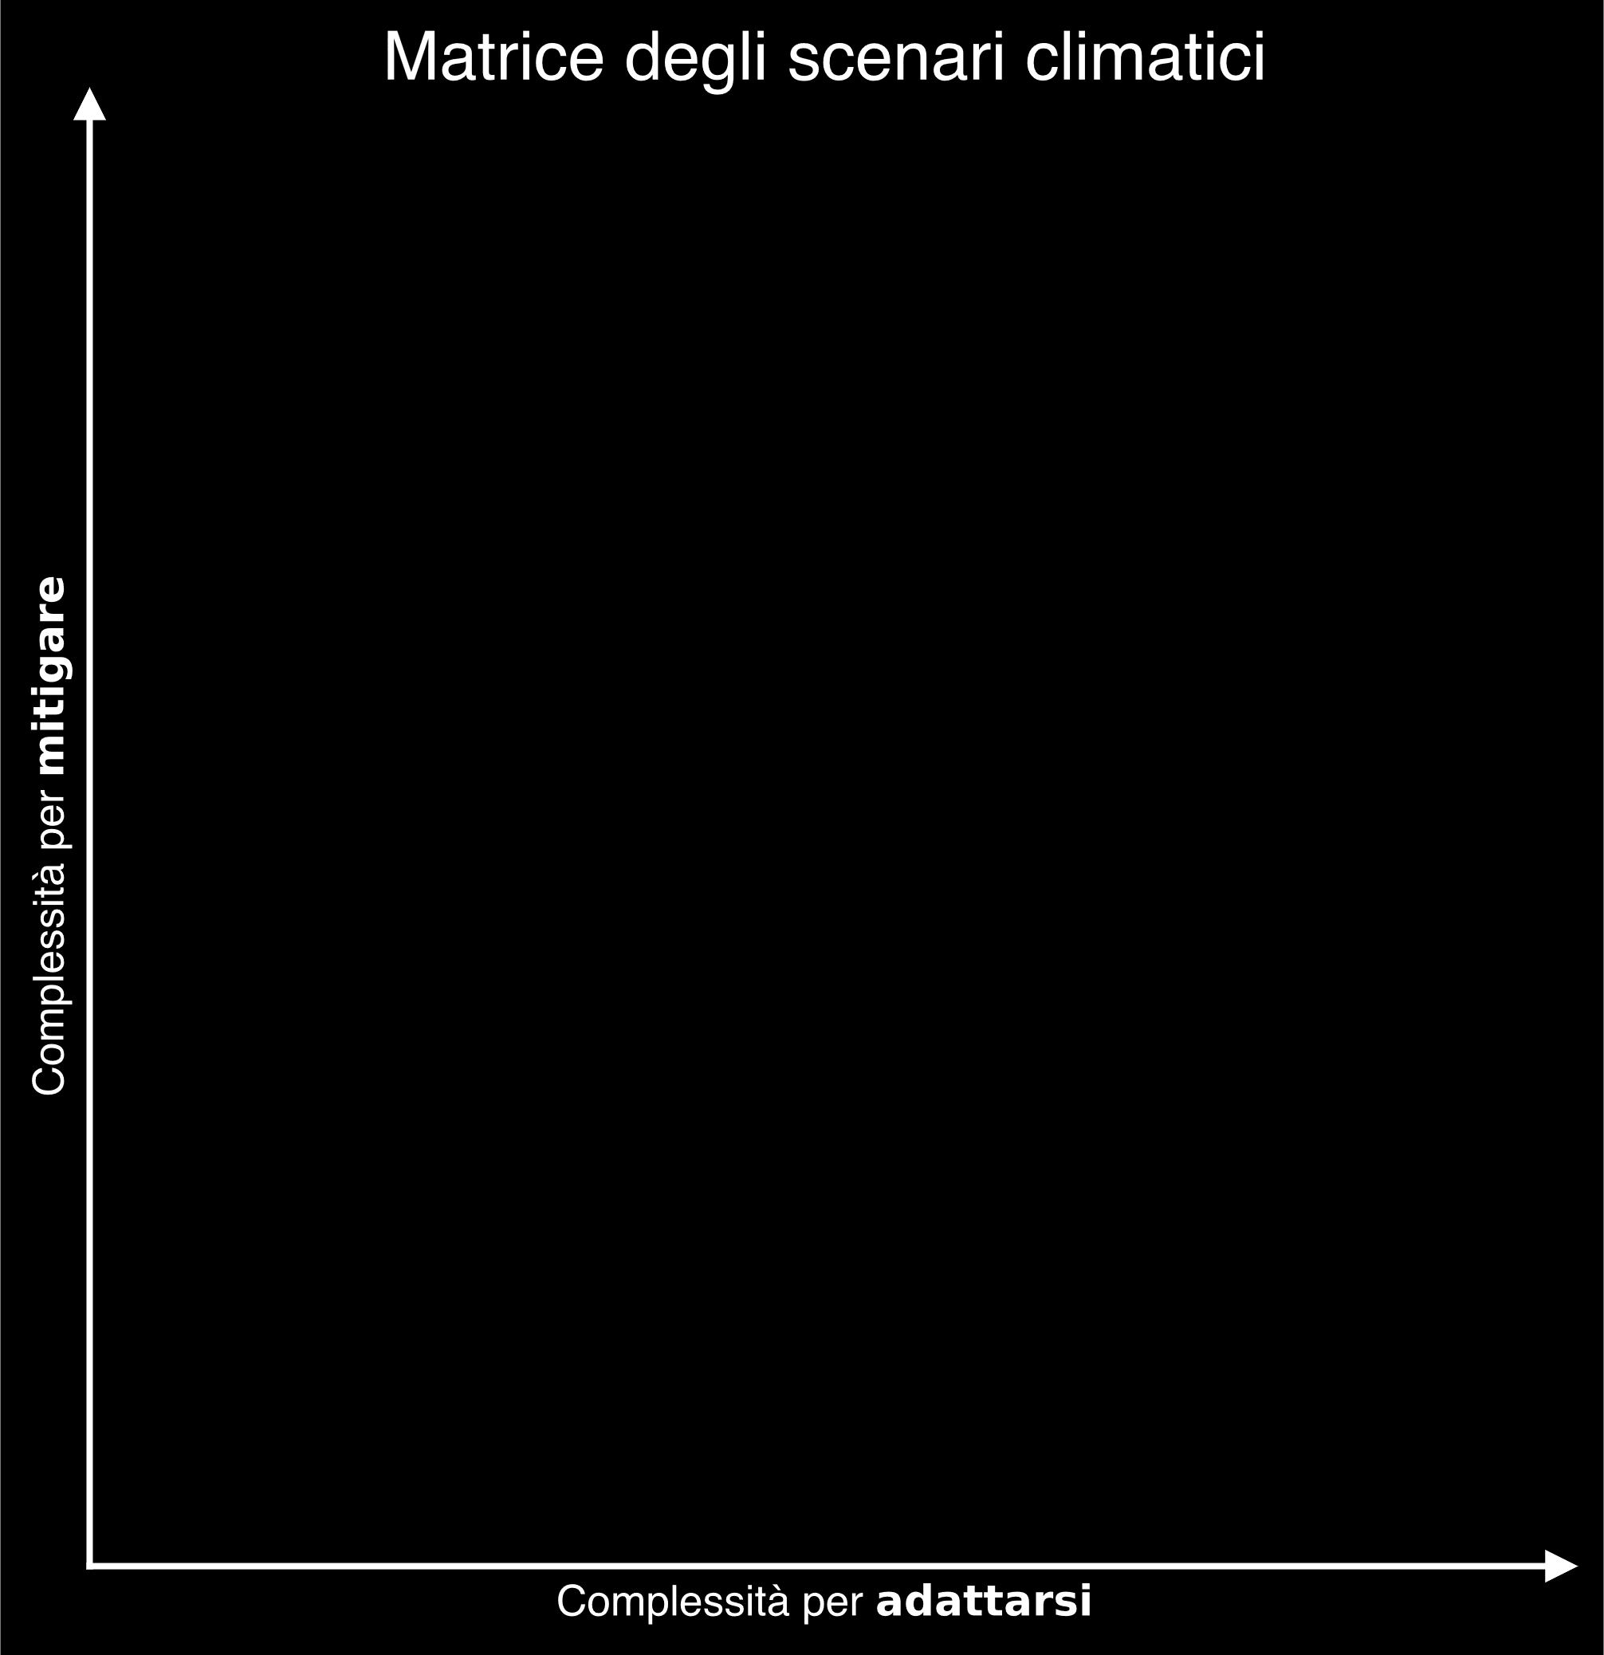

Speaker
Robin Castellani

Slide 8
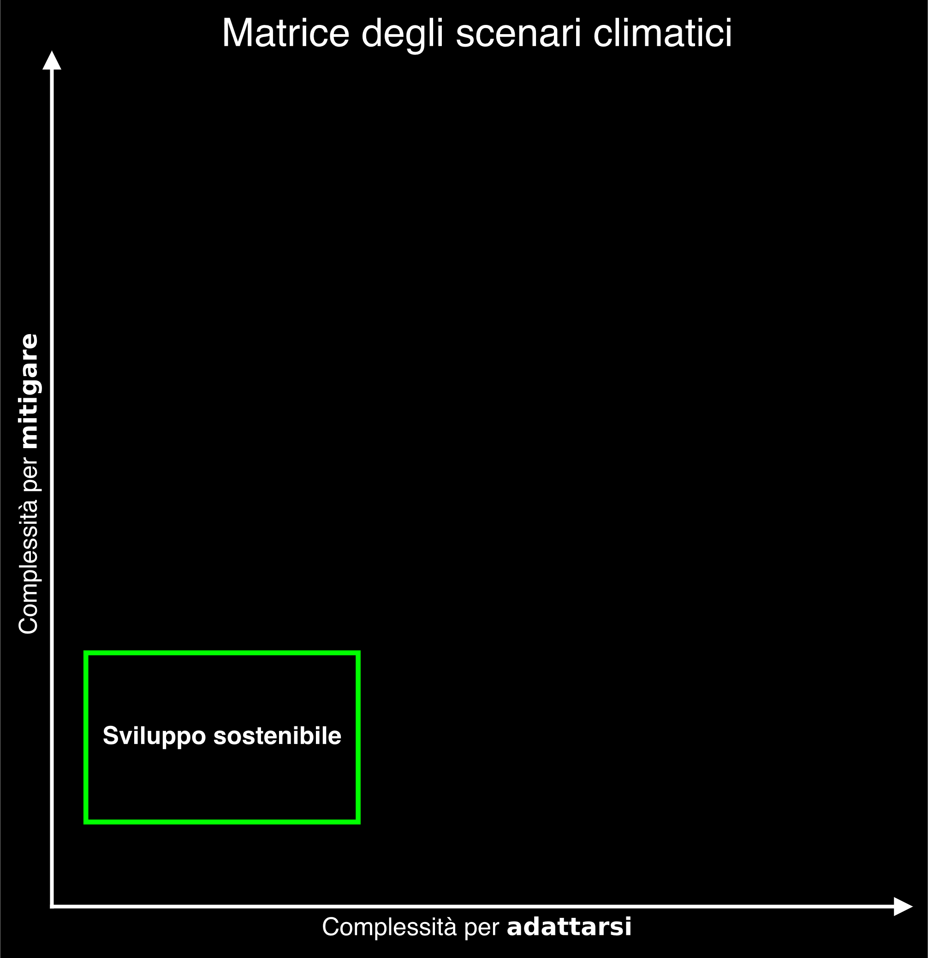
Speaker
Robin Castellani

Slide 9
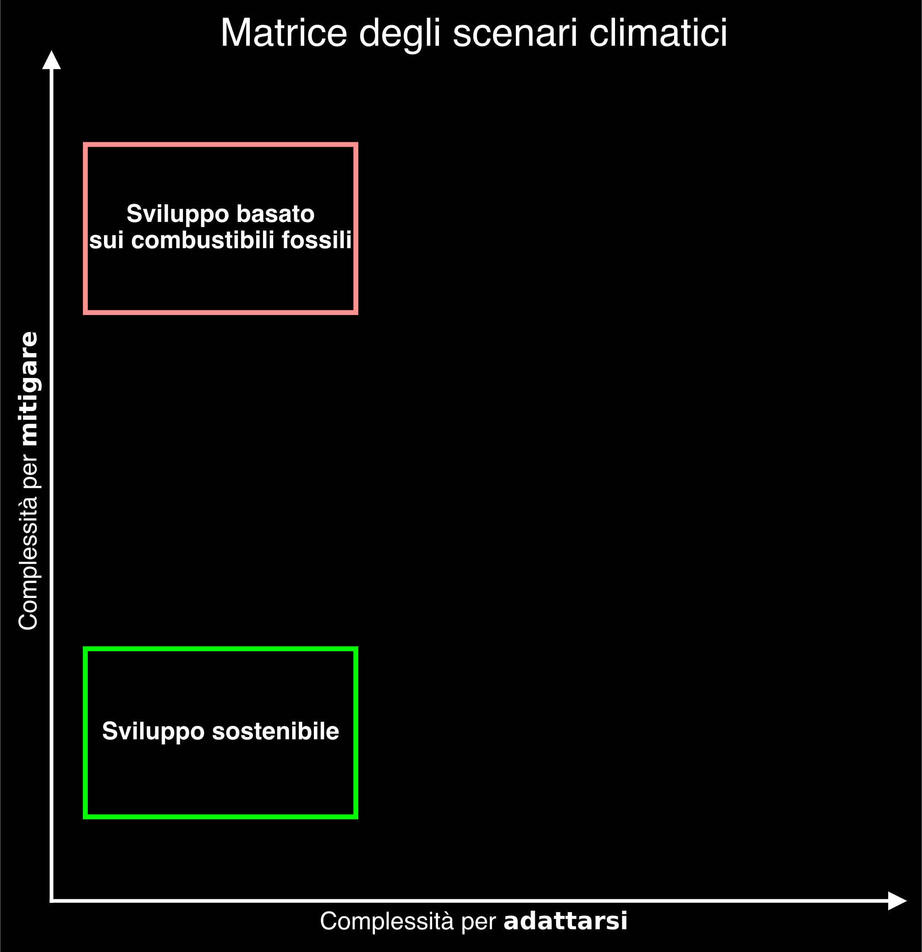
Speaker
Robin Castellani

Slide 10
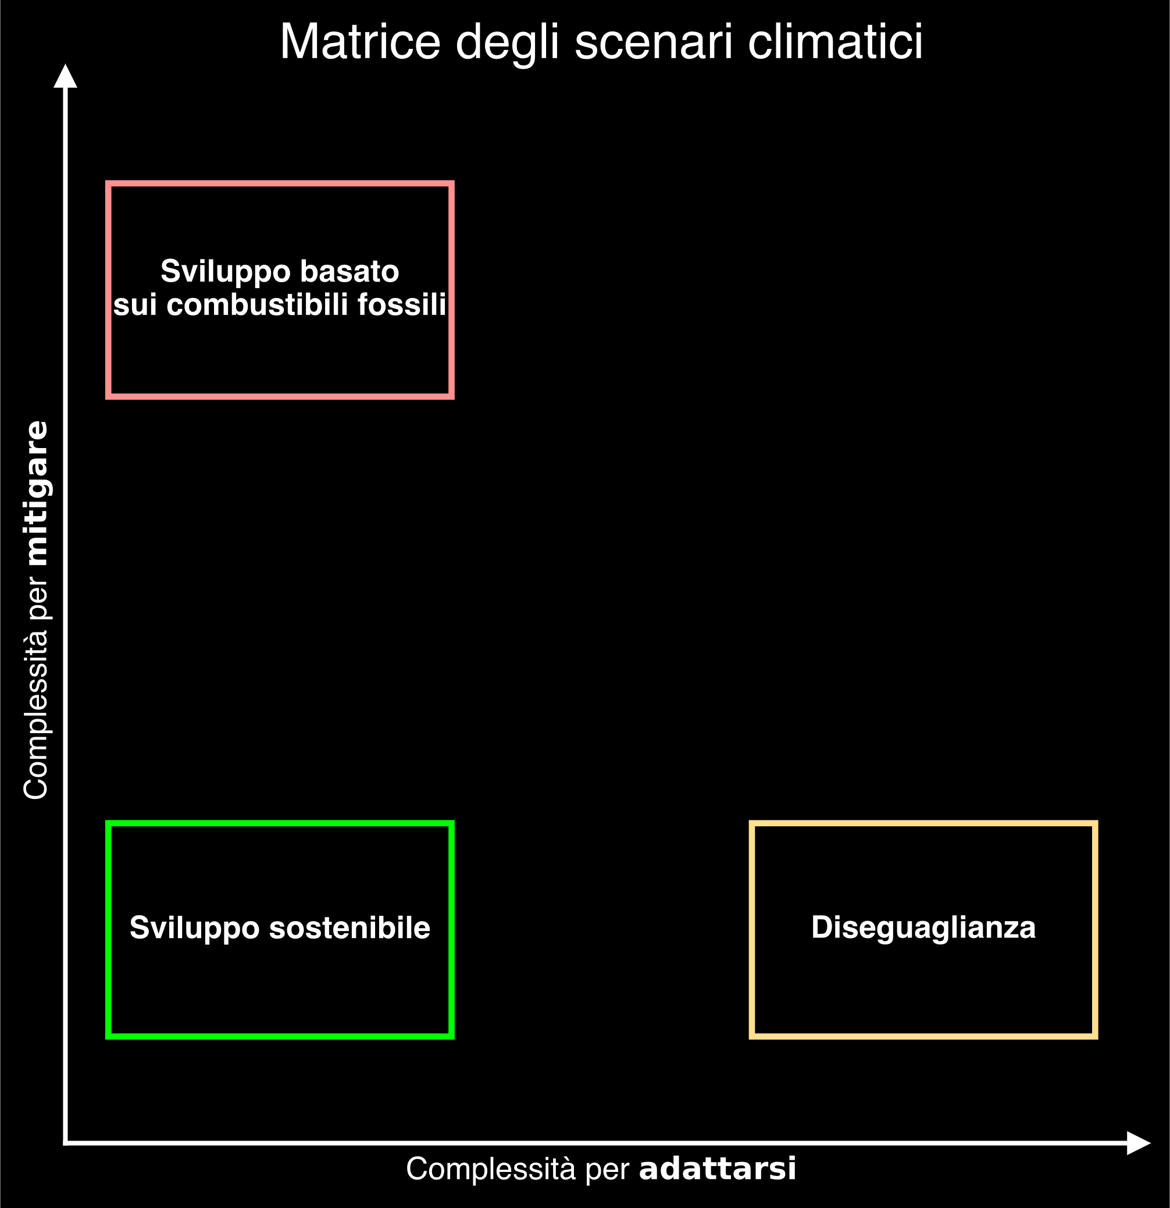
Speaker
Robin Castellani

Slide 11
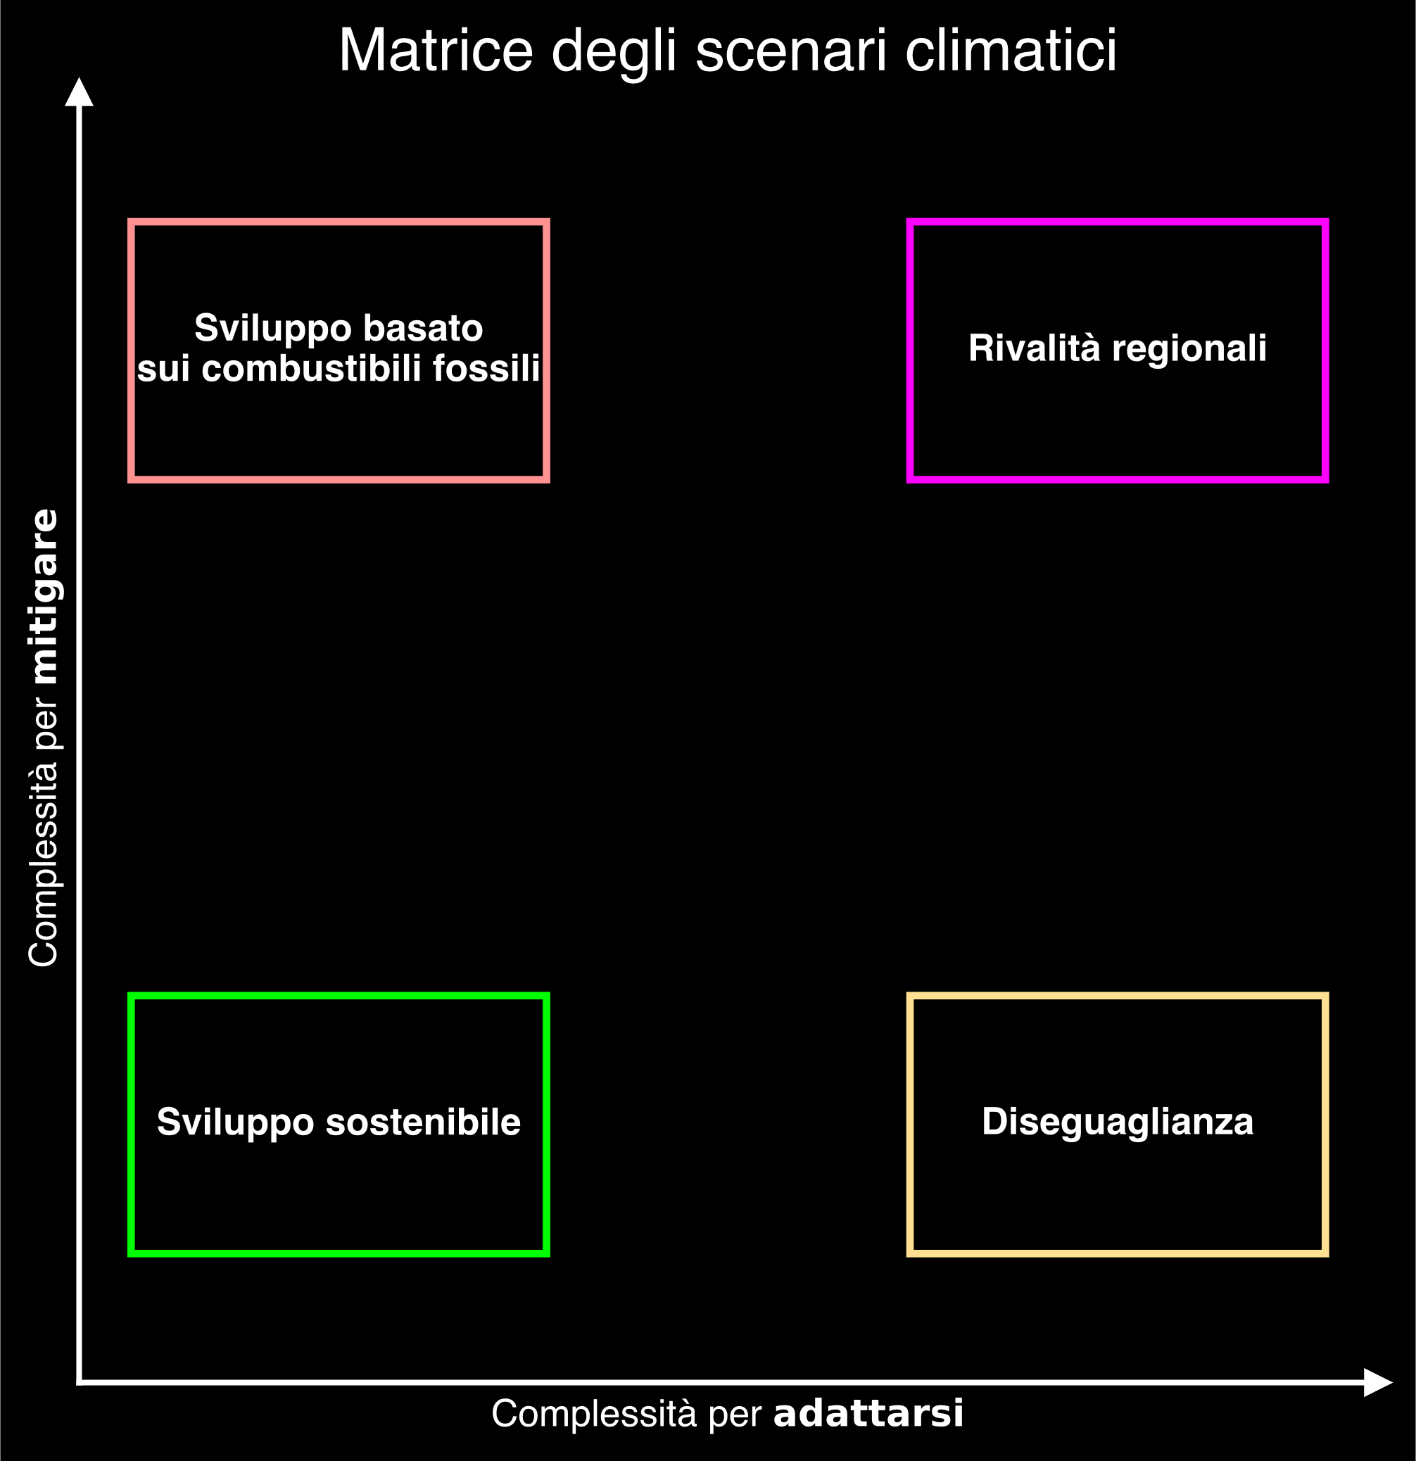
Speaker
Robin Castellani

Slide 12
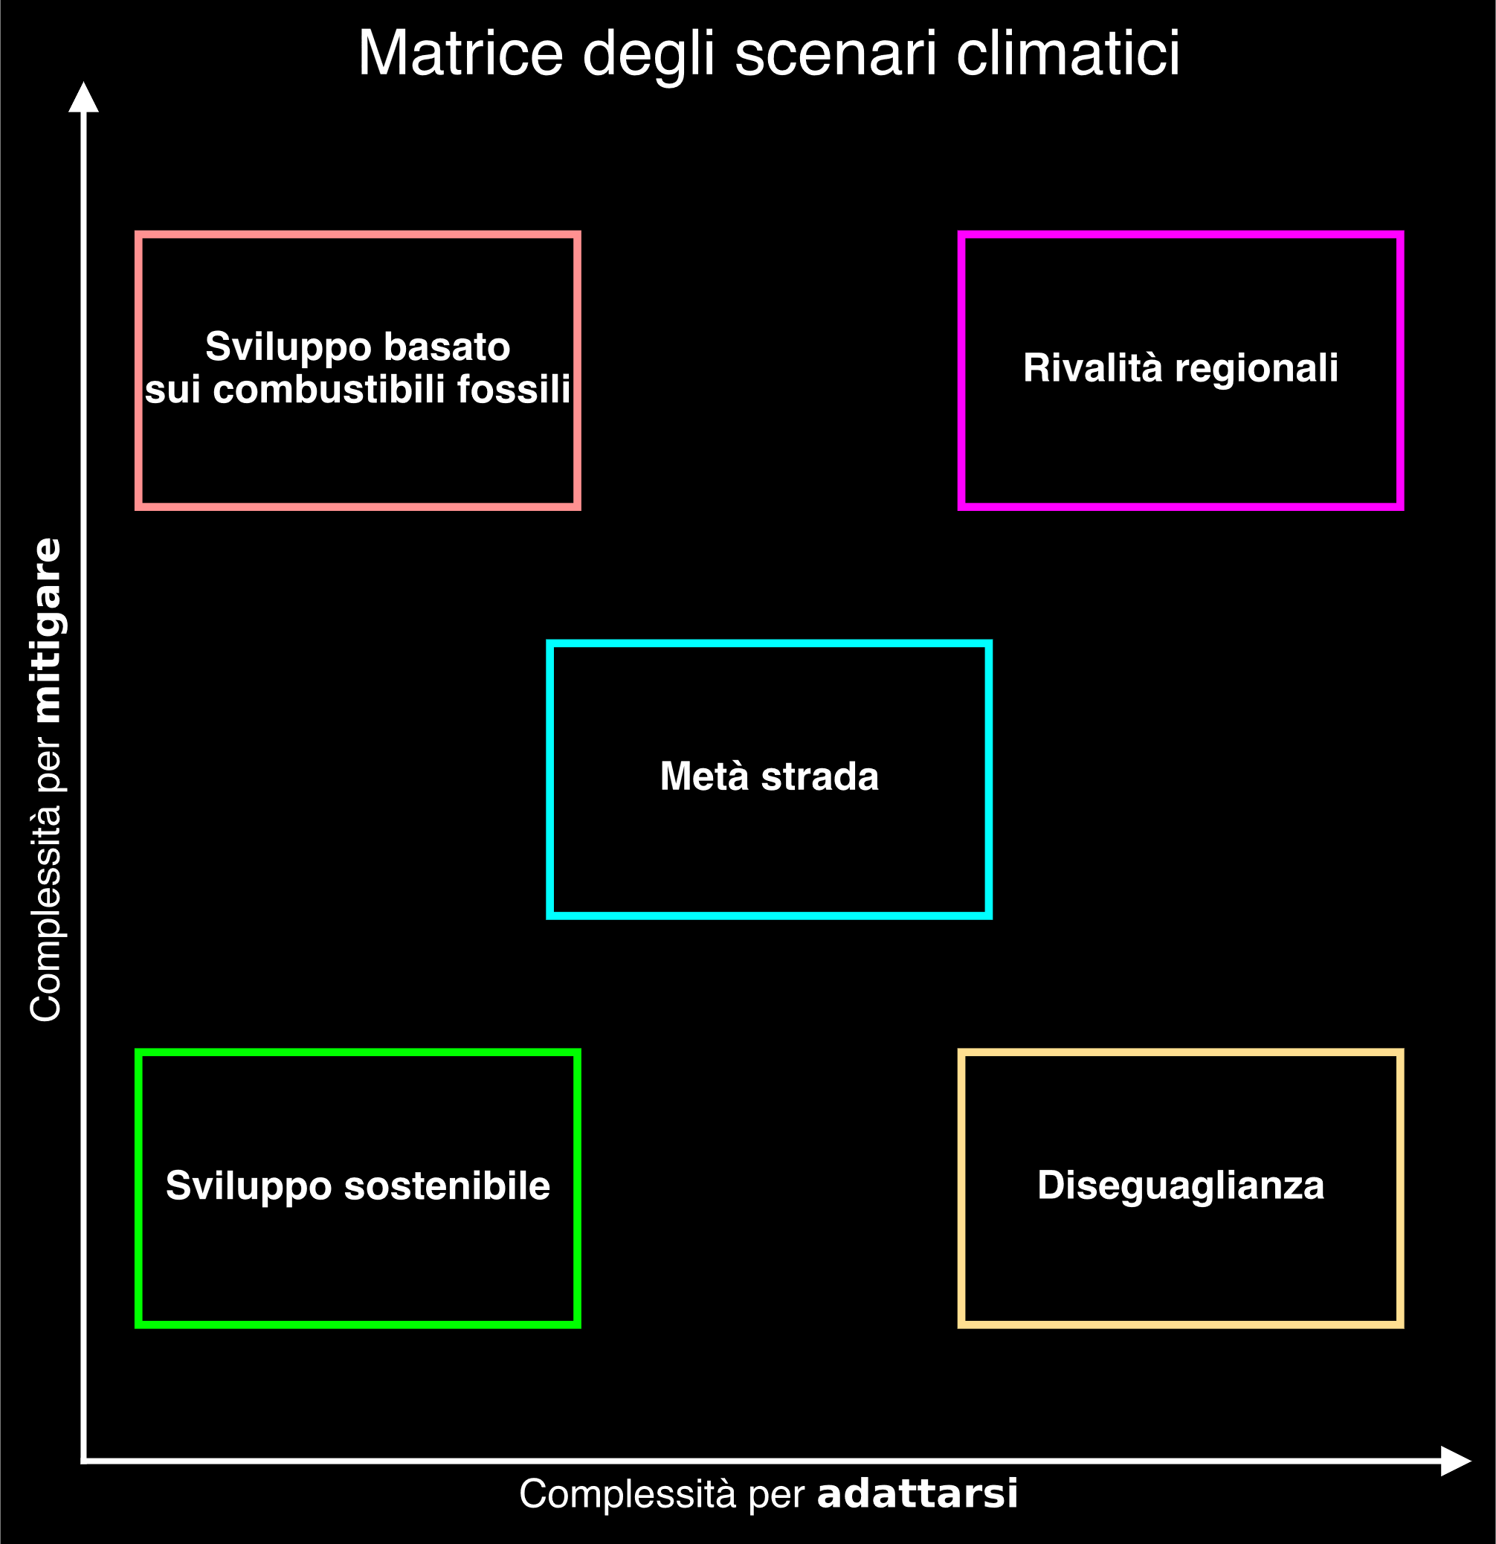
Speaker
Robin Castellani

Slide 13
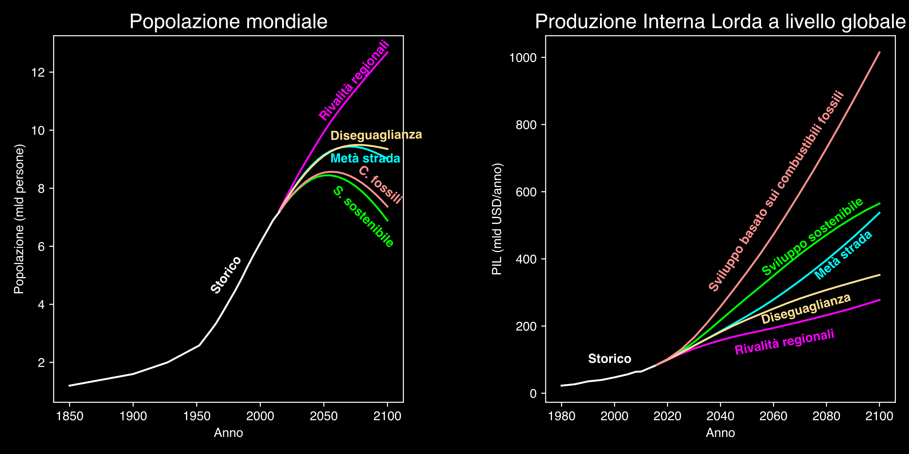
Speaker
Robin Castellani
K. Riahi et al., The Shared Socioeconomic Pathways and their energy, land use, and greenhouse gas emissions implications: An overview, Global Environmental Change, Volume 42, Pages 153-168, 2017, ISSN 0959-3780, DOI:110.1016/j.gloenvcha.2016.05.009
K. Riahi et al.,

Slide 14
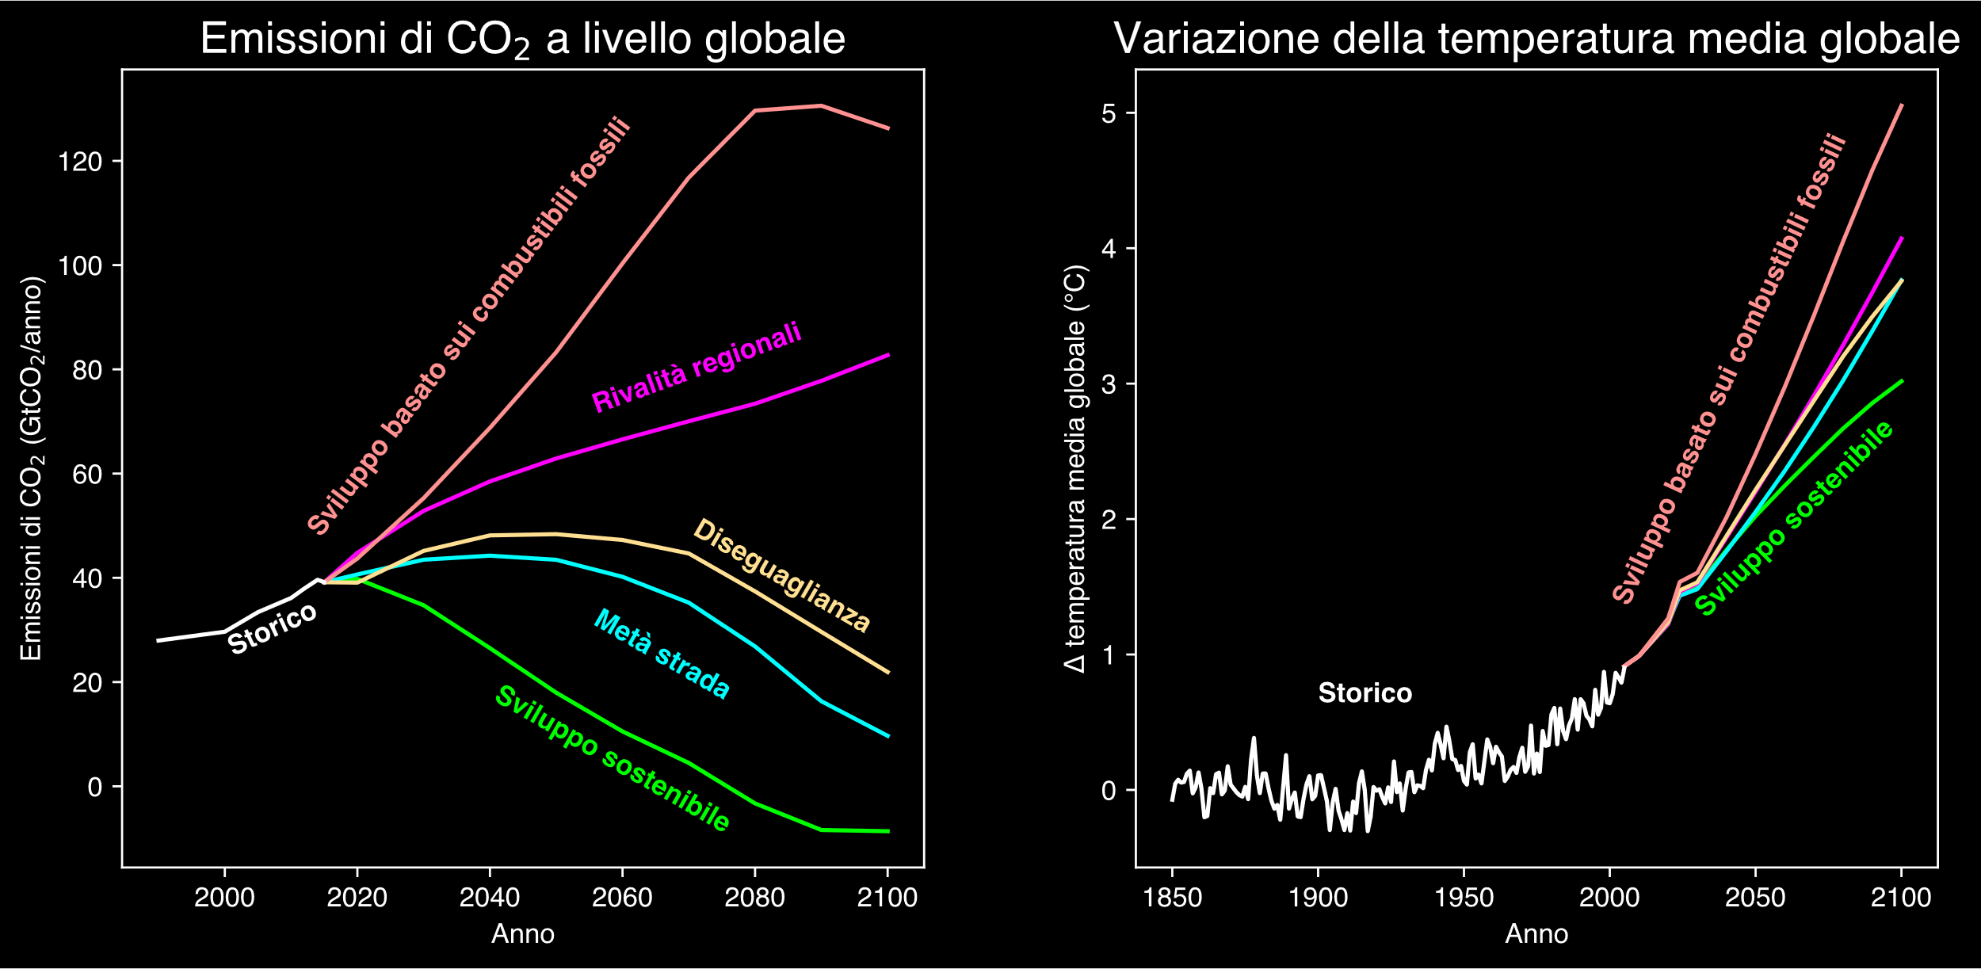
Speaker
Robin Castellani
K. Riahi et al., The Shared Socioeconomic Pathways and their energy, land use, and greenhouse gas emissions implications: An overview, Global Environmental Change, Volume 42, Pages 153-168, 2017, ISSN 0959-3780, DOI:110.1016/j.gloenvcha.2016.05.009

Slide 15
Speaker
Robin Castellani
Copernicus Climate Change Service (2022): Global sea level change indicators from 1950 to 2050 derived from reanalysis and high resolution CMIP6 climate projections. Copernicus Climate Change Service (C3S) Climate Data Store (CDS). DOI: 10.24381/cds.6edf04e0

Slide 16
Speaker
Robin Castellani
Copernicus Climate Change Service (C3S), Climate Data Store (CDS), (2024): Climate indicators for Europe from 1940 to 2100 derived from reanalysis and climate projections, Copernicus Climate Change Service (C3S) Climate Data Store (CDS).

Slide 17
Speaker
Robin Castellani
Copernicus Climate Change Service, Climate Data Store, (2019): Climatic suitability for the presence and seasonal activity of the Aedes albopictus mosquito for Europe derived from climate projections. Copernicus Climate Change Service (C3S) Climate Data Store (CDS). DOI: 10.24381/cds.d08ed09a

Slide 18
Speaker
Robin Castellani
Le nostre scelte definiscono il cambiamento climatico

Slide 19
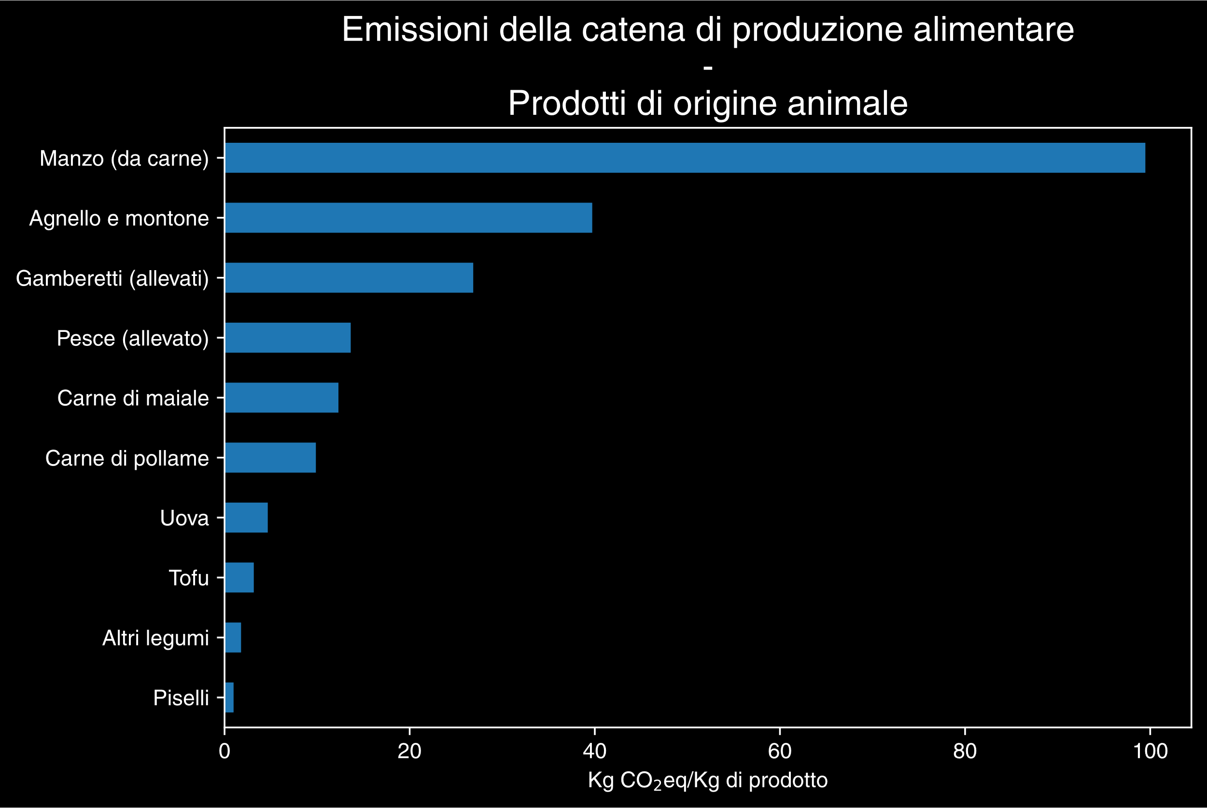
Speaker
Robin Castellani
Hannah Ritchie, Pablo Rosado and Max Roser (2022) - “Environmental Impacts of Food Production” Published online at OurWorldinData.org. Retrieved from: 'https://ourworldindata.org/environmental-impacts-of-food' [Online Resource]

Slide 20
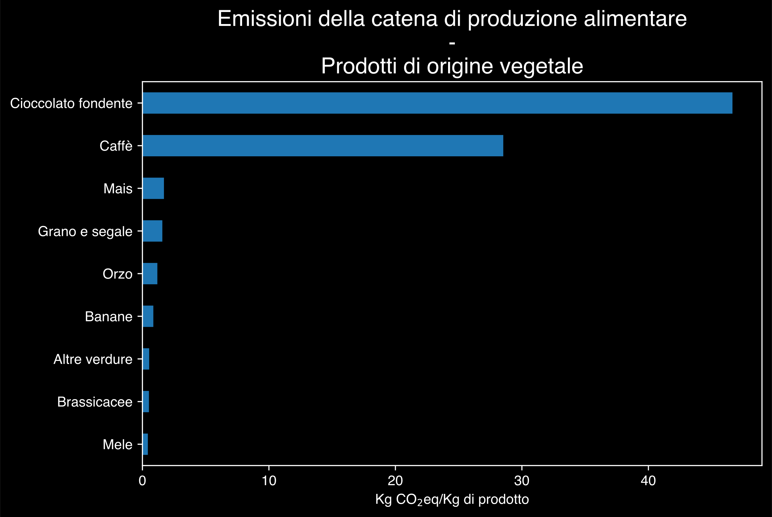
Speaker
Robin Castellani
Hannah Ritchie, Pablo Rosado and Max Roser (2022) - “Environmental Impacts of Food Production” Published online at OurWorldinData.org. Retrieved from: 'https://ourworldindata.org/environmental-impacts-of-food' [Online Resource]

Slide 21
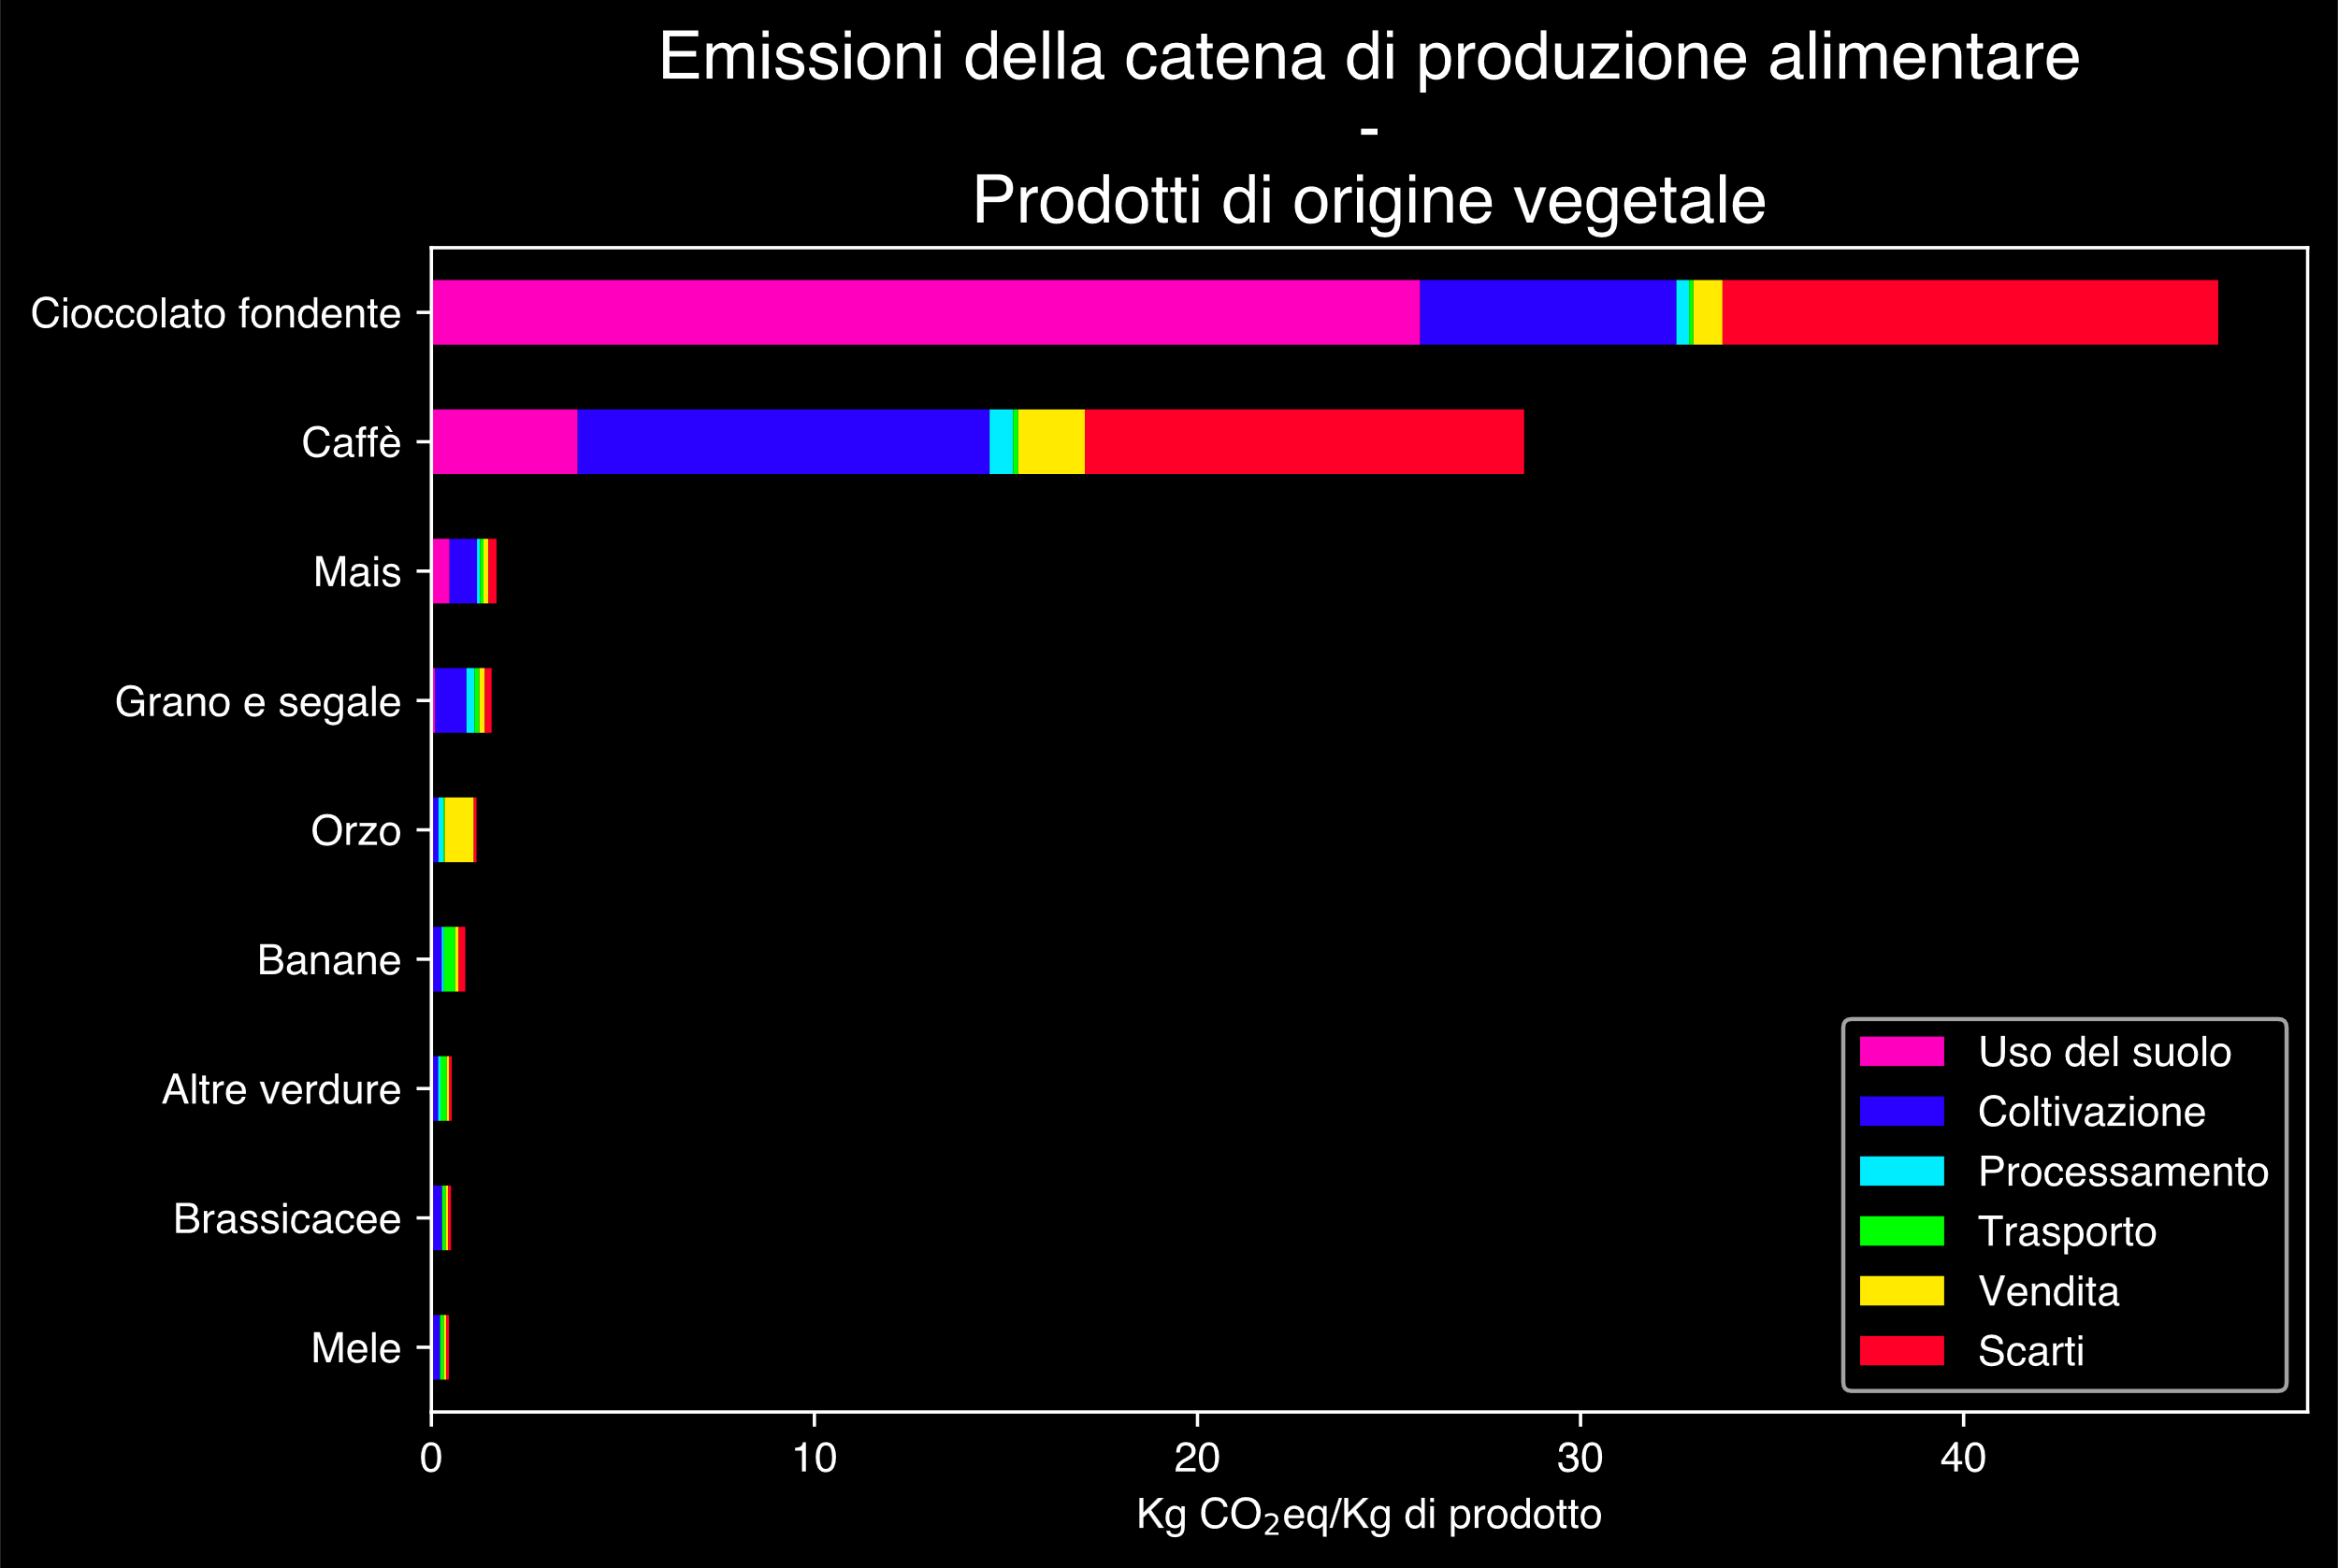
Speaker
Robin Castellani
Hannah Ritchie, Pablo Rosado and Max Roser (2022) - “Environmental Impacts of Food Production” Published online at OurWorldinData.org. Retrieved from: 'https://ourworldindata.org/environmental-impacts-of-food' [Online Resource]

Slide 22
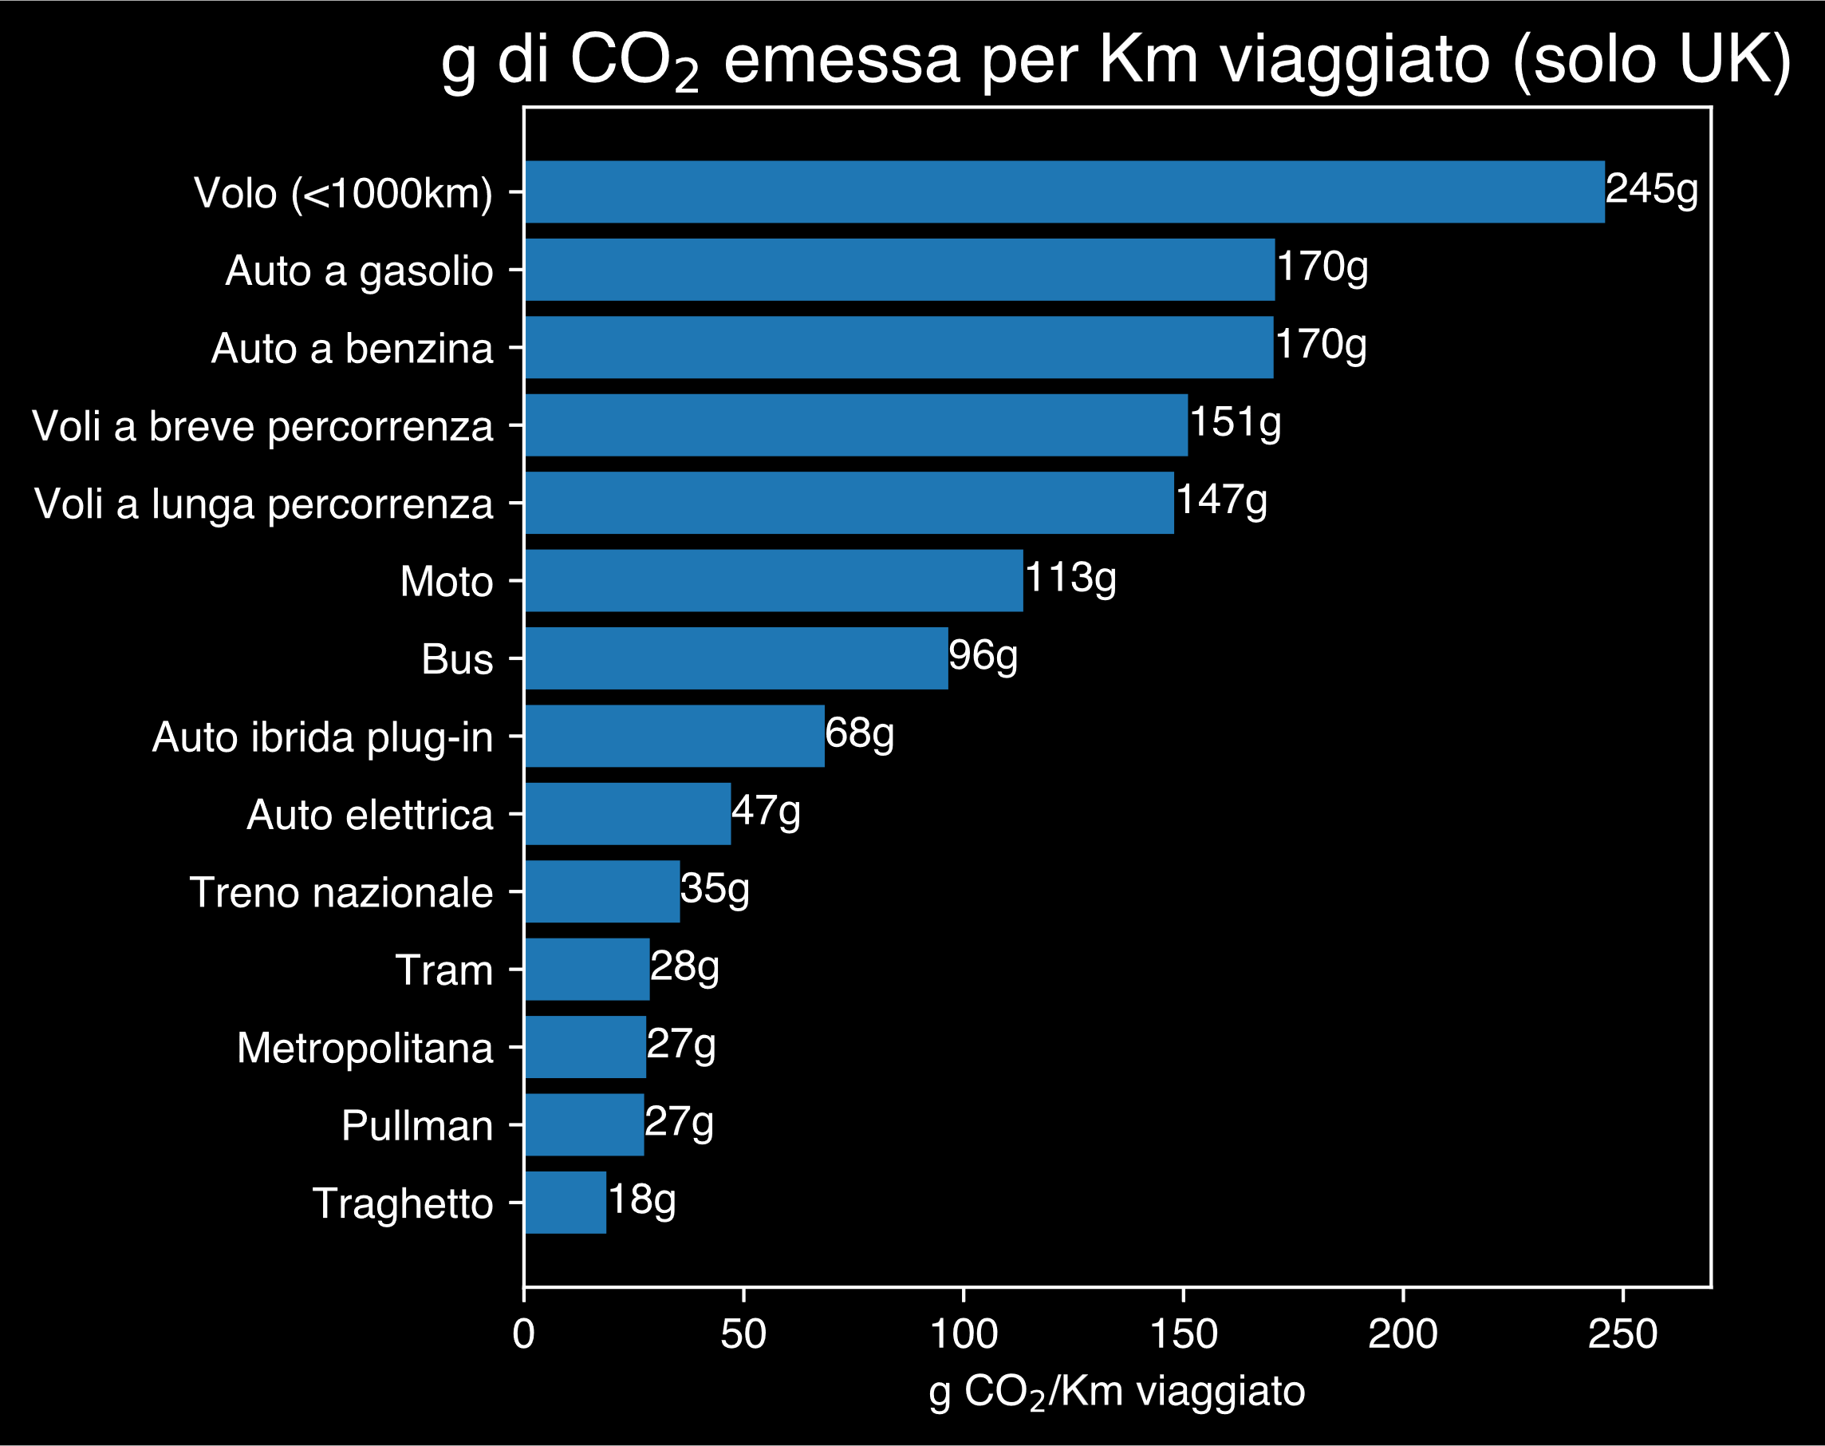
Speaker
Robin Castellani
Hannah Ritchie (2023) - “Which form of transport has the smallest carbon footprint?” Published online at OurWorldinData.org. Retrieved from: 'https://ourworldindata.org/travel-carbon-footprint' [Online Resource]

Slide 23
Speaker
Robin Castellani
Si può ancora fare di più
🧑‍🚒Segui la Protezione Civile del tuo territorio.
🗳️Ricorda l’importanza del tuo voto.
🛡️Preparati per adattarti al nuovo clima.

Slide 24
Speaker
Robin Castellani
Fronteggiare il cambiamento climatico significa fronteggiare il futuro di ciascuno di noi

